Slide 1

Note: The data and information in this document is reflective of a hypothetical situation and client. This document is to be used for KPMG Virtual Internship purposes only.
Sprocket Central Pty Ltd
Data analytics approach
[Division Name] - [Engagement Manager], [Senior Consultant], [Junior Consultant]

Slide 2
Note: The data and information in this document is reflective of a hypothetical situation and client. This document is to be used for KPMG Virtual Internship purposes only.
Agenda
Introduction
Data Exploration
Model Development
Interpretation

Slide 3
Note: The data and information in this document is reflective of a hypothetical situation and client. This document is to be used for KPMG Virtual Internship purposes only.
Introduction
Indentify and Recommend Top Customers to Target from the Dataset.
Problem Outline
Sprocket Central is company that specializes in high quality bikes and cycling accessories.
Their marketing team is looking to boost their sales by analyzing the dataset.
Using the datset provided we aim to recommend the top customers which the comapny should target to drive high value for the company.
Content of Data Analysis
Customer Age Distribution on both
'Old' and 'New' customers.
Bike related purchases over last 3
years by gender.
Job Industry Distribution for both
'Old' and 'New' Customers.
RFM Analysis and Customer
Classification.

Slide 4
Note: The data and information in this document is reflective of a hypothetical situation and client. This document is to be used for KPMG Virtual Internship purposes only.
Data Exploration
Data Quality Assessment and 'Clean Up'.
Summary Table
Key Issues for Data Quality Assessment:
Completeness: Data Fields and values
Accuracy: Correct Values
Consistency: Value free of contradiction
Currency: Values up to date
Validity: Data Contaning Allowable values
 | Completeness | Accuracy | Consistency | Currency | Validity
Customer Demographic | - Job title:Blanks | - DOB : Inaccurate- Age: column missing | - Gender:inconsistent | - Deceased Customers: Filtered
Transactions | - online order: blanks- brand: blanks |  |  |  | - list_price:format - Product sold date: format
Customer Address |  |  | - States: inconsistent

Slide 5
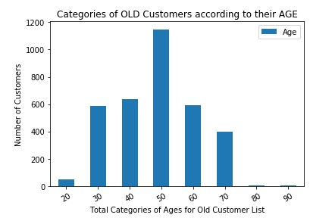
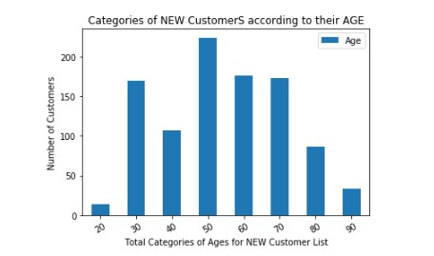
Data Exploration
Customer Age Distribution on Both 'Old' and 'New' Customers.
Most of the customer belong in both Old and New Customer list belong to Age group of 40-49 .
The lowest Age groups are under 20 and above 80 in both New and Old Customers.
Most populated Age groups in Old Customer list are 30-60.
Most populated Age groups in New Customer list are 40-70.

Slide 6
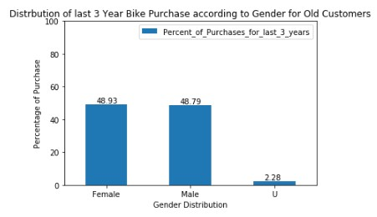
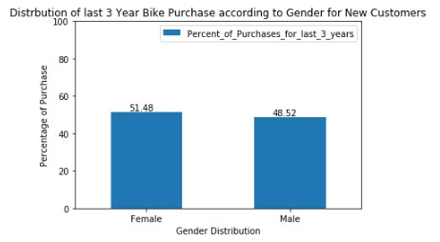
Data Exploration
Bike Related Purchases for last 3 Years
Over the last 3 years around 50% of the purchases were made by female 48% by male an 2 % by unknown gender.
For the New customer there are 51% of females as they numerically purchase more than males.
Females make majority of bike related purchases.

Slide 7
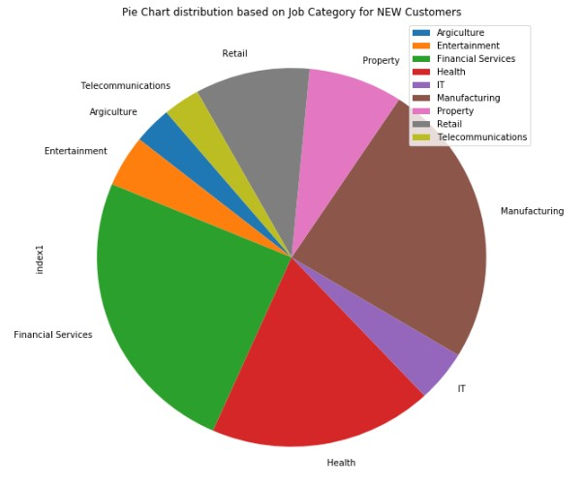
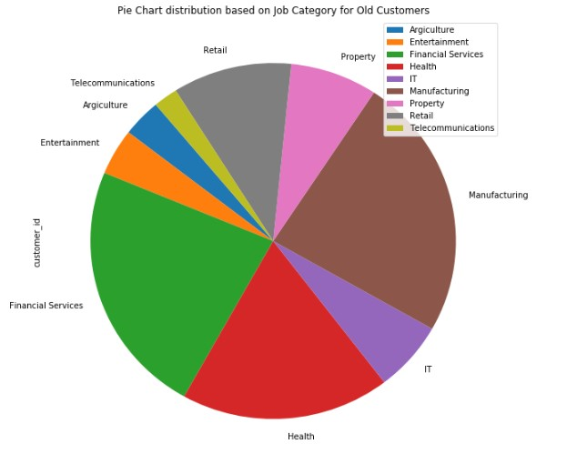
Data Exploration
Job Industry Distribution
Maximun number of customer in both Old and New belong to Financial services and Manufacturing
Least customer distribution in in Telecommunications and Agriculture industy.

Slide 8
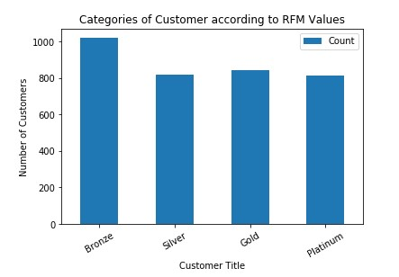
Model Development
RFM Analysis and Customer Segmentation
RFM Analysis is used to determine which customer a business should target to increase their revenue.
The RFM(Rmecency, Frequency and Monetary) models shows the distribution of customers based on their rfm values as they are distributed in 4 categories in which Platinum customers are the one who are the most valued customers and bronze the least to be targeted.

Slide 9
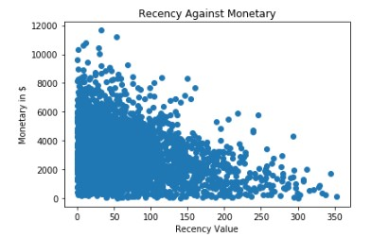
Model Development
Scatter-Plot based off RFM Analysis
This plot shows the customers who purchased recently generated more revenue.
More revenue was generated by customers who visited in past 0-100 days.
Low revenue was generated by the customers who purchased 200 days ago.

Slide 10
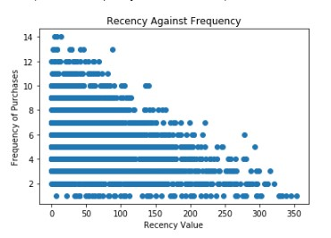
Model Development
Scatter-Plot based off RFM Analysis
Low recency is corrlated to frequncy i.e more recent customers tend to visit frequently.
Customers with high recency would tend to be less frequent i.e recency with more than 250 days.
High Rcencency has negative correlation with Frequency of purchase as recececy increase customers tend to be less frequent.

Slide 11
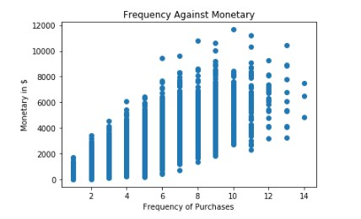
Model Development
Scatter-Plot based off RFM Analysis
Customers with high frequency naturally generate more revenue which are the Platinum and the Gold classified customers from the RFM Analysis.

Slide 12
Interpretation
Customer Target and Methodology
Table after RFM Analysis
Filter through the top customers from the result of the RFM analysis which would give the customers who are to be targeted the most to increase the revenue.
The top customer would be the Platinum and the Gold Category of customer which are to be calculated as to generate most revenue and are more frequent.
Customer Title | Count of the Customers
Platinum | 811
Gold | 844
Silver | 817
Bronze | 1020

Slide 13
Note: The data and information in this document is reflective of a hypothetical situation and client. This document is to be used for KPMG Virtual Internship purposes only.
Appendix

Slide 14
Note: The data and information in this document is reflective of a hypothetical situation and client. This document is to be used for KPMG Virtual Internship purposes only.
Appendix
This is an optional slide where you may place any supporting items.

